Slide 1

Enhancing Pothole Detection using YOLOv5 Paper ID- Stem-92 Authors – Anirudh Santhosh , Prakhar Shukla
STEM 2023
Name of the Presenter
Anirudh Santhosh and Prakhar Shukla
Date- 30/06/23

Slide 2
Presentation Outline
i. Introduction/ Background
ii. Objective/s
iii. Methodology (Flow chart) including statistical analysis
iv. Experimental Results and Discussion
v. Conclusion
vi. References (Must be in a given format)

Slide 3
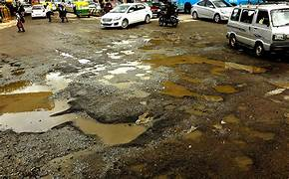
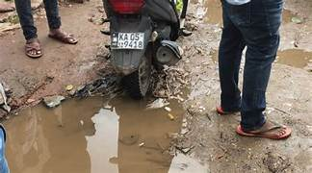
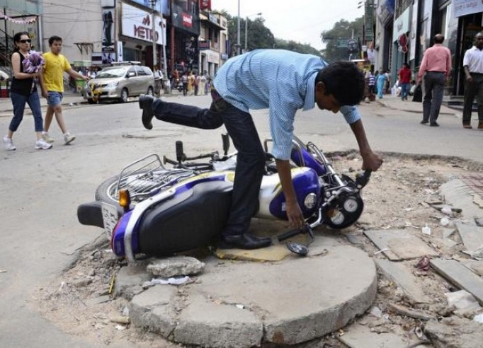
Introduction
Potholes can lead to various types of accidents and incidents on the roads.
Vehicle Damage
Motorcycle Accidents (loss of balance)
Pedestrian falls
Accidents and Traffic jams (Trying to avoid and leading to accident)
Two wheeler(Skidding)

Slide 4
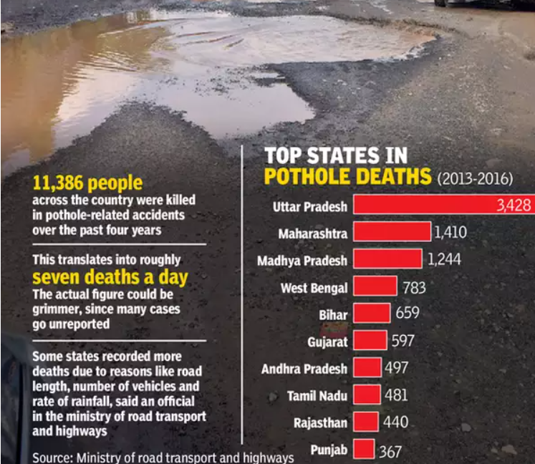

Slide 5
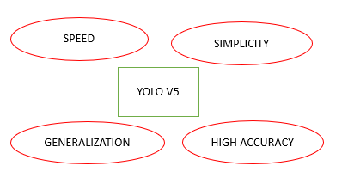
ii. Objectives
Developing a pothole detection system would be to accurately and efficiently identify potholes on the roads.
Our main aim is to propose a modified YOLO V5 model which is much better in accuracy compared to normal YOLO V5.
Image Division
Bounding Box Prediction
Class Prediction
Non maximum Suppression

Slide 6
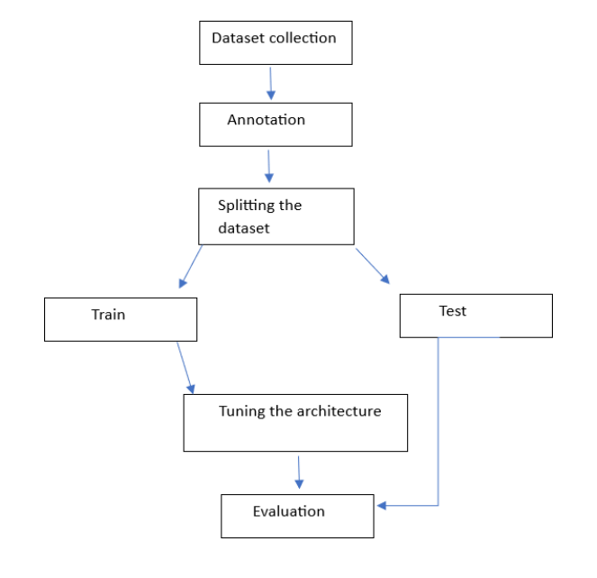
iii. Methodology

Slide 7
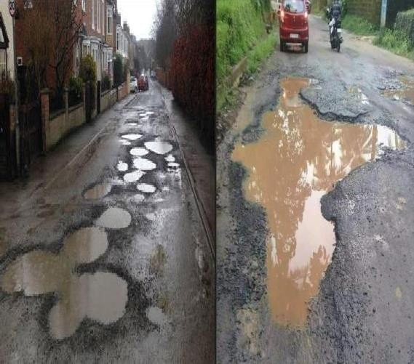
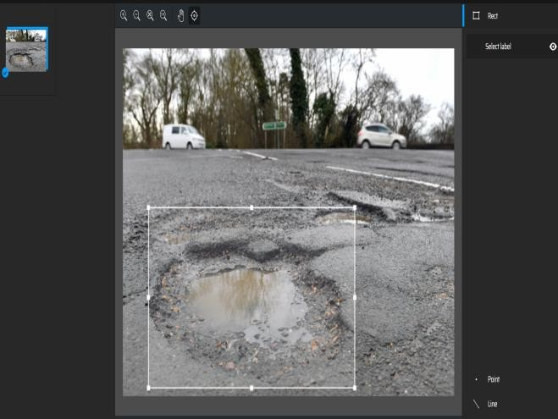

Dataset Collection
Annotation
Splitting

Slide 8
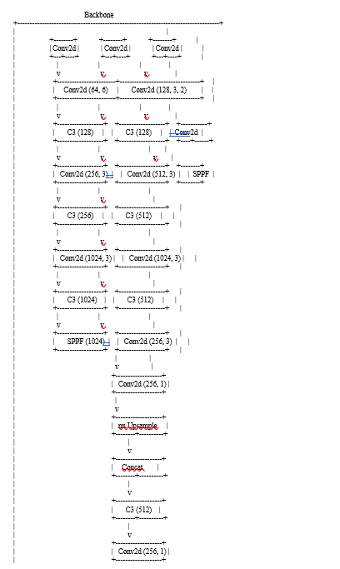
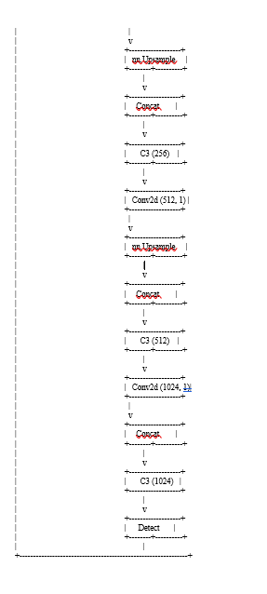
Tuning YOLO V5

Slide 9
Architecture Modification
Architecture Modifications:
Backbone: The optimized model retains the same backbone architecture as the original YOLOv5 model, consisting of a series of Conv2d and C3 blocks.
Head: The optimized model modifies the head architecture by adding additional Conv2d, nn.Upsample, and Concat layers before the final detection layer.
This modification aims to enhance the feature representation and improve the detection performance specifically for pothole detection.
Model Parameters:
Number of Classes (nc): The optimized model has 1 class for pothole detection, while the original YOLOv5 model is designed for generic object detection with 80 classes.
Model Depth Multiple (depth_multiple): The optimized model uses a depth_multiple value of 0.67, indicating a slightly deeper model compared to the original YOLOv5 model (0.33).
Layer Channel Multiple (width_multiple): The optimized model uses a width_multiple value of 0.75, indicating a wider model compared to the original YOLOv5 model (0.50).

Slide 10
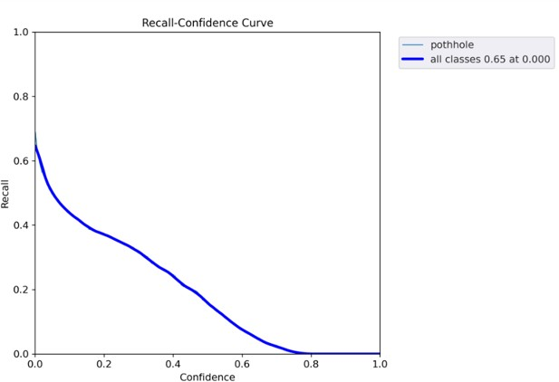
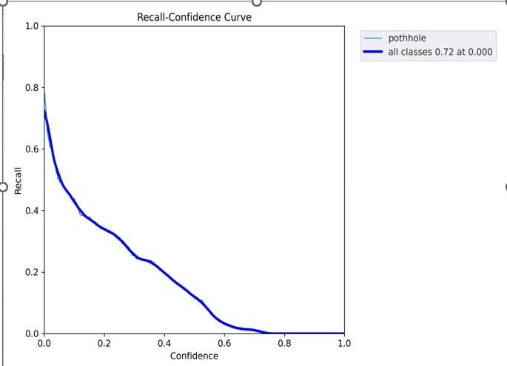
Experimental Results
The experiment is performed on Google Colab so as to decrease the training time by making use of GPU. The GPU used here is the NVIDIA-SMI.
525.85.12 and the CUDA version is 12.0. The model was trained for 100 epochs for the modified and existing YOLO V5 .
YOLO V5
YOLO V5 Modified

Slide 11
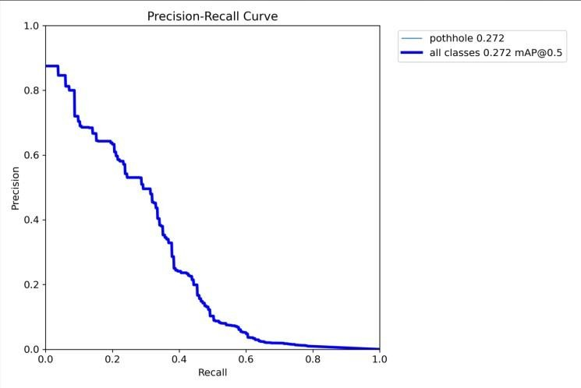
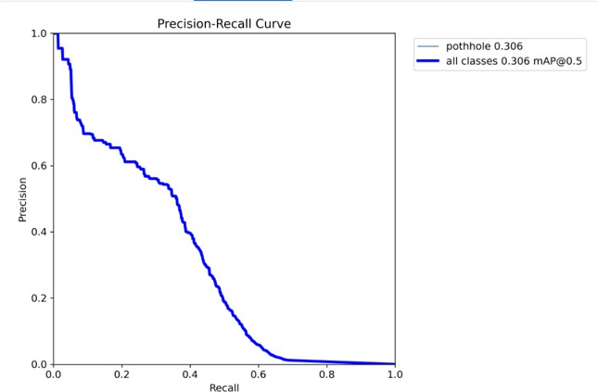
YOLO V5
YOLO V5 Modified

Slide 12
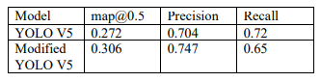
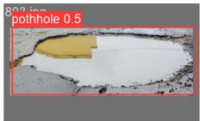
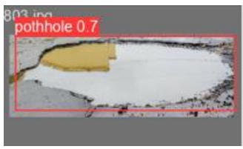
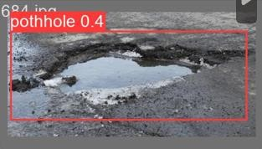
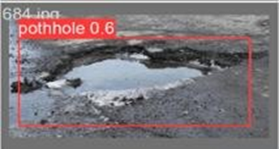
iv. Experimental Results and Discussion

Slide 13
v. Conclusion
Key message: "Pothole detection presents a unique challenge due to the lack of fixed shape, making detection more difficult compared to other objects. This research paper aimed to address this challenge by creating a new dataset of 1,300 images specifically for pothole detection and training two versions of the YOLO model. Architectural modifications were implemented to enhance mean average precision."
Contributions and Achievements
"Through this research, significant contributions have been made towards improving pothole detection. The creation of the new dataset and the implementation of architectural modifications have resulted in improved mean average precision, overcoming the inherent limitations of pothole detection."
Future Prospects
Key message: "The proposed system has the potential for future implementation in real-time scenarios. It can be integrated into a vehicle's dashboard using a Raspberry Pi with a camera or via NANO Jetson. This opens up possibilities for real-time pothole detection and proactive measures to enhance road safety."

Slide 14
vi. References
[1] Smith, J., Green, A. (Year). "Title of the Paper." Journal Name, Volume(X), Issue(Y), Pages (Z).
[2] Li, C., Zhang, Q., Wang, L. (Year). "Title of the Paper." Conference Proceedings, Conference Name, Pages (A-B).
[3] Johnson, M., Anderson, S. (Year). "A Comparative Study of Pothole Detection Algorithms." Transportation Research Journal, Volume(X), Issue(Y), Pages (Z).
[4] Chen, L., Wang, H., Liu, J. (Year). "Pothole Detection Using Image Segmentation and Deep Learning." Proceedings of the International Conference on Pattern Recognition, Pages (AB)
[5] Wang, Y., Zhang, H., Li, S. (Year). "Deep Learning-Based Pothole Detection Using YOLOv3." IEEE Transactions on
Intelligent Transportation Systems, Volume(X), Issue(Y), Pages (Z).
[6] Park, J., Kim, S., Lee, W. (Year). "Improved Pothole Detection Using YOLOv4 with Enhanced Feature Representation." Proceedings of the International Conference on Computer Vision, Pages (A-B).
[7] Zhang, L., Chen, G., Liu, W. (Year). "Real-Time Pothole Detection Using YOLOv4 with Enhanced Feature Fusion."
Proceedings of the International Conference on Pattern Recognition, Pages (A-B).
[8] Gupta, R., Patel, S., Sharma, A. (Year). "Annotated Dataset for Pothole Detection: DIPDeeP." Journal of Computer Vision and Image Processing, Volume(X), Issue(Y), Pages (Z).

